Slide 1

Az National Trucking
Big Data – Group #8
Akhil Akkiraju, Akshata Bodhankar, David Kassin, Karthik Mahanth Kattula, Behab Patnaik, Fatima Wali, and Esther Banegas Mejia

Slide 2
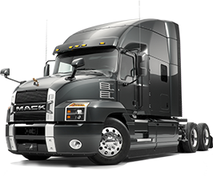
Problem Statement & Objective
Problem statement
ANT has noticed an increase of unsafe drivers in the fleet who are not following rules and regulations. The company is afraid this could present insurance risks and other repercussions that can negatively impact the organization.
objective
ANT has identified number of events/total miles as a riskfactor with a threshold of seven. Management is required to identify those drivers who are not following rules and regulations of the corporation.

Slide 3

Analysis Workflow Diagram
Moving csv files into Image/VM
Move files to Cloudera VM using scp command(Local System(Laptop) to VM )
Load Data into HDFS
Copy csv files from local file system(VM local Unix file system) to HDFS using hdfs dfs put command
Create HIVE tables for csv files
Creating table schema for csv files and derived tables
Load data from HDFS to HIVE tables
Loading data from HDFS to HIVE tables using LOAD DATA INPATH and INVALIDATE METADATA in IMPALA so that both HIVE and IMPALA are in sync
Tableau Integration
Download ODBC drivers and connect to Cloudera Hadoop, Impala using localhost ip address

Slide 4
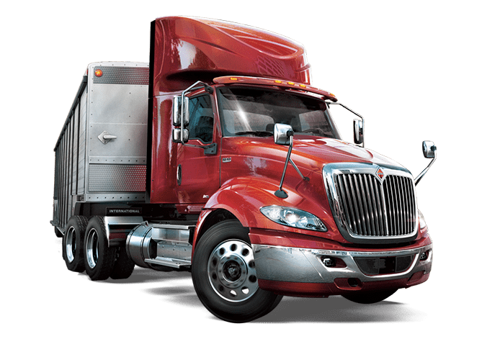
Visualization Overview
Filters
Charts
Safe/Unsafe Drivers
Top X% of Drivers
Model
City
Event
Year
Month
Risk by Truck ID
Distribution of Risk by Truck ID
Risk by Cities
Scatter Plot of Risk and Velocity by Model
Risk by Events
Detailed Driving Statistics of the Drivers

Slide 5
Visualization Assumptions
Truck id = driver id and will always remain so. Hence risk by truck is the same as risk by driver.
Risk factor is defined as events/total miles.
The dashboard does not take into consideration those trucks who do not have events tied to them. We ensured this by doing an inner join with the riskfactor table.

Slide 6
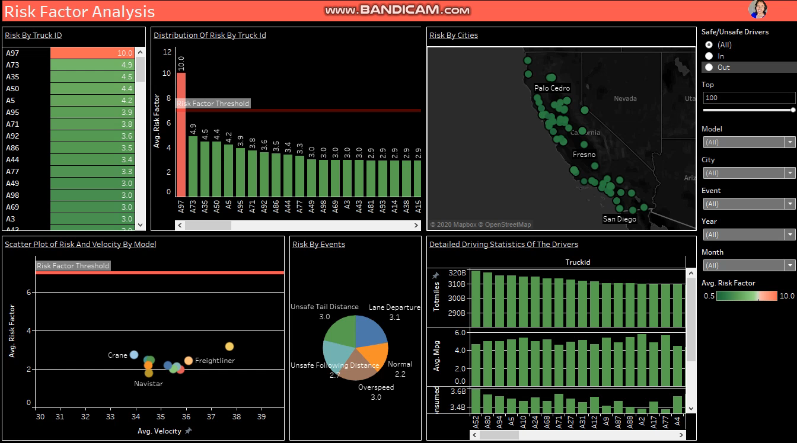
Dashboard in action

Slide 7
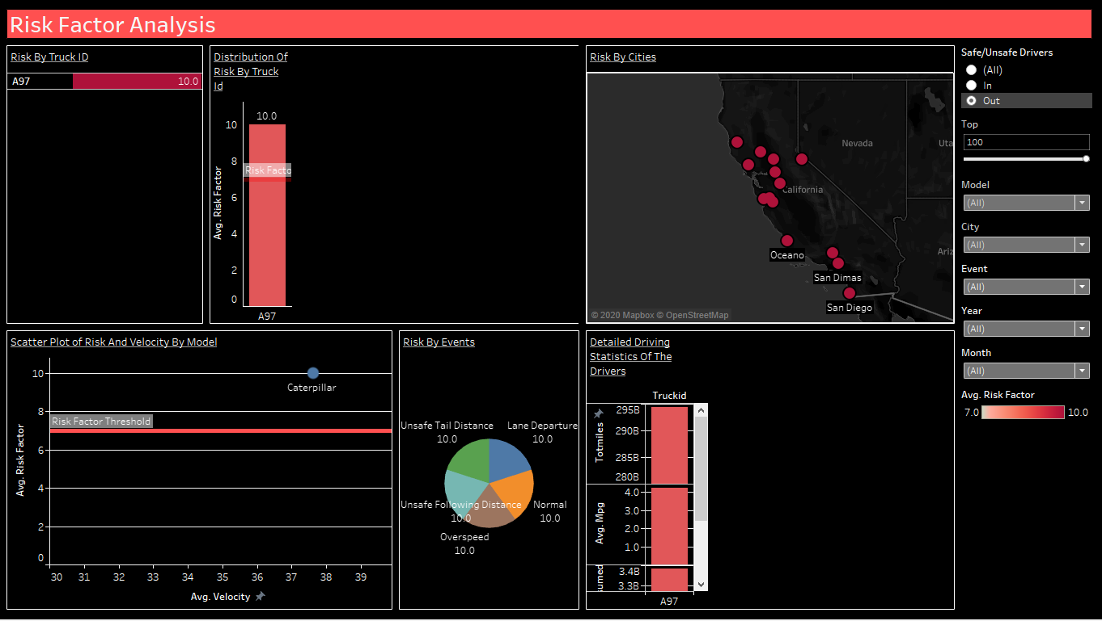
Unsafe Driver

